Slide 1

Megaminx
MMR 2020 – Group 3

Slide 2
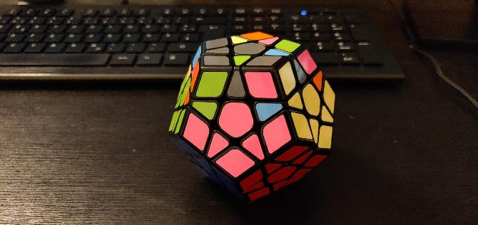
Goals
Reminder: Goal 94

Slide 3
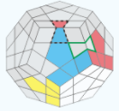
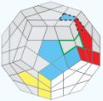
ALGORITHMS
SP8
SP9
(U R U‘ R‘ U‘) (F‘ U F)
(R‘ F‘ R U)(R U‘ R‘ F)

Slide 4
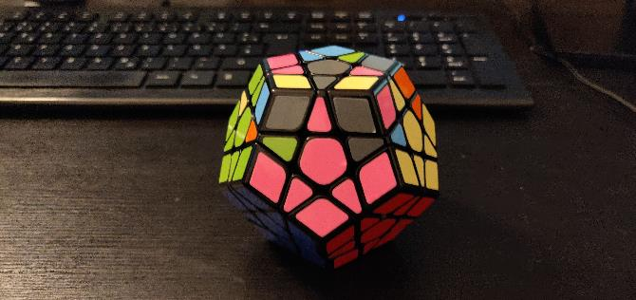
Goals
Goal 95
Moves: all

Slide 5
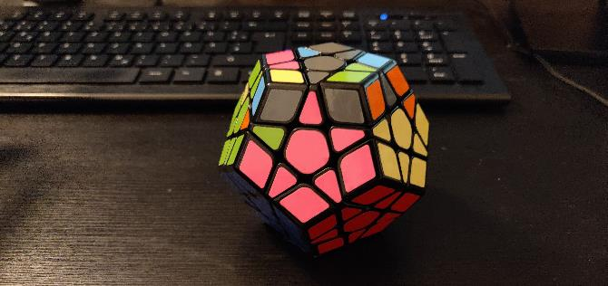
Goals
Goal 96
Moves: sp8, sp9

Slide 6
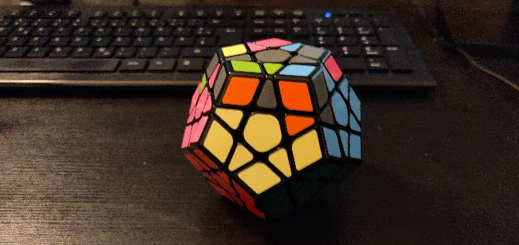
Goals
Goal 97
Moves: r_v

Slide 8
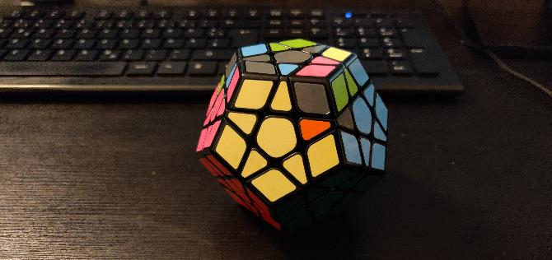
Goals
Goal 98
Moves: all

Slide 9
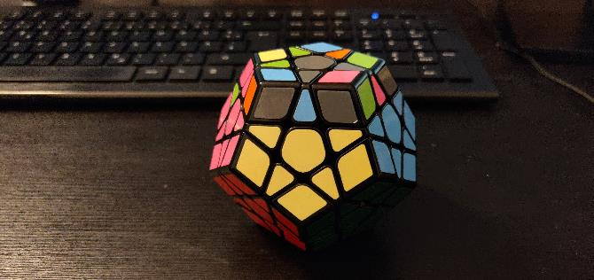
Goals
Goal 99
Moves: sp8, sp9

Slide 10
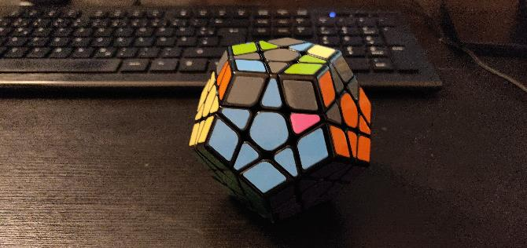
Goals
Goal 100
Moves: r_v

Slide 12
Goals
Goal 101
Moves: all

Slide 13
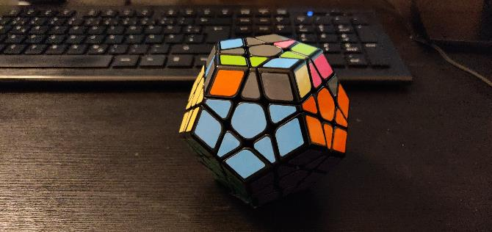
Goals
Goal 102
Moves: sp8, sp9

Slide 14
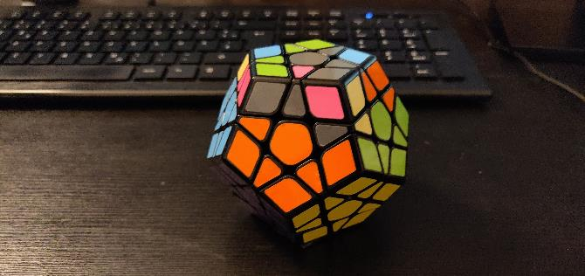
Goals
Goal 103
Moves: r_v

Slide 16
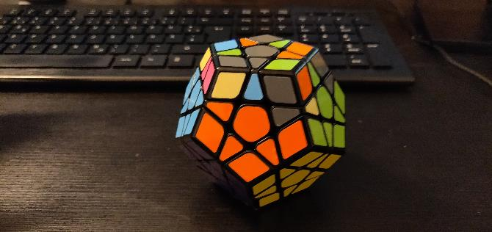
Goals
Goal 104
Moves: all

Slide 17
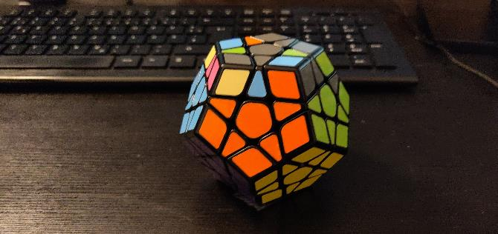
Goals
Goal 105
Moves: sp8, sp9

Slide 18
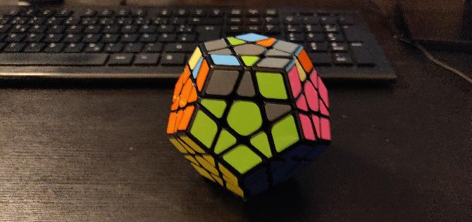
Goals
Goal 106
Moves: r_v

Slide 20
Goals
Goal 107
Moves: all

Slide 21
Goals
Goal 108
Moves: sp8, sp9

Slide 22
Goals
Goal 109
Moves: r_v

Slide 24
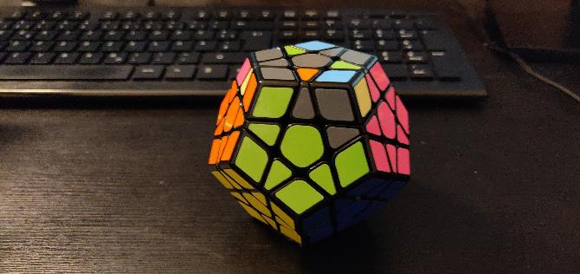
Goals
Goal 110
Moves: all

Slide 25
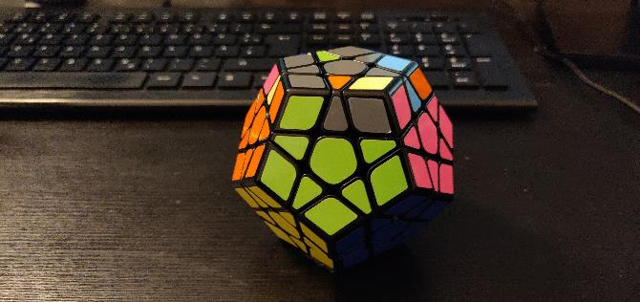
Goals
Goal 111
Moves: sp8, sp9

Slide 26
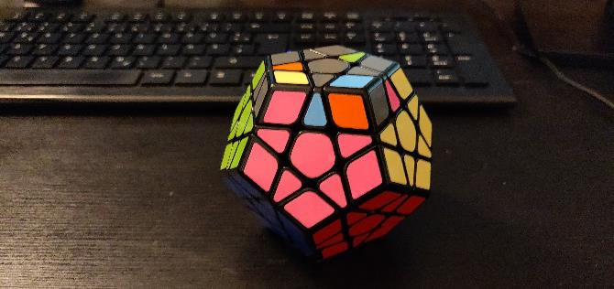
Goals
Goal 112
Moves: r_v

